Slide 1
Artificial Intelligence
Support Vector Machines I

Slide 2
Overview
New material: Support Vector Machines

Slide 3
Second term topics: details
Data exploration and preparation (1 week)
We need to add some of the basic bits we skipped last term
Evaluation (2 weeks)
Really important: we all need to know the important methods for establishing exactly how well our ML methods are performing
Feature extraction (2 weeks)
Really interesting topic: if our data doesn’t have a really obvious consistent structure (e.g., text documents, images) then how should we extract features
Support Vector Machines (2 weeks)
A final “black box” technique we think you should have some exposure to (e.g., visualising, tuning hyperparameters)
Then over to Deep Learning with Nick (3 weeks, not assessed)

Slide 4
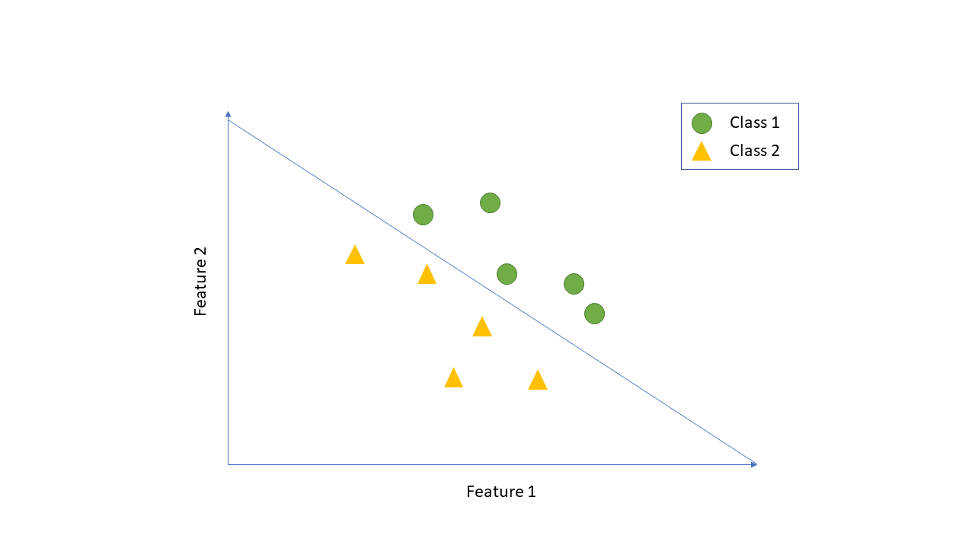
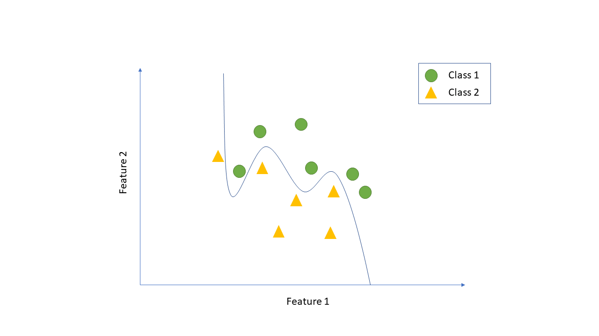
Last week’s reading
Hopefully you recognised the main ideas behind Support Vector Machines (SVMs) from the very first week
A classifier that tries to draw a dividing line between the data in two classes…
…You have some control (via hyperparameters) over whether the line should be allowed to curve, and if so by how much

Slide 5
SVMs: mathematics
The full formulation is very mathematical
Like patch-based features/dimensionality reduction in previous weeks…
…People have spent entire professional lives working on these ideas
It’s not our aim to learn all of the details…
…But to have an appreciation of the important ideas
…To be able to use SVMs in Matlab

Slide 6
SVMs: important steps
Important ideas to cover:
Binary classification only
Linear boundaries
The margin
Soft margins
Nonlinear boundaries
The KernelScale hyperparameter
Matlab syntax
Visualisation and other considerations

Slide 7
Binary classification only
You can only use an SVM to separate two different classes
This sounds like a big limitation, but…
…There are ways to solve multi-class problems with multiple binary SVMs
(We’ll come back to this next week…)
For everything in the upcoming slides, you should be thinking about a simple binary problem, where you’re trying to separate data from two different classes

Slide 8
We’ll stick with the sketching conventions used in previous weeks…
We won’t bother to show the legend on every slide:
Class 1
Class 2
Feature 2
The boundary goes on for ever, but we’ll only plot it inside the axes…
Or the axes labels:
Feature 1

Slide 9
The benefit of finding the boundary is that we can use it to classify new examples:
New data
Classify new data based on which side of the line it falls
Feature 2
Feature 1

Slide 10
The benefit of finding the boundary is that we can use it to classify new examples:
Class 1
Class 2
Classify new data based on which side of the line it falls
Feature 2
Feature 1

Slide 11
Linear boundaries: in words
The boundary an SVM creates is straight/flat (linear)
Appears to clash with what we saw in the earlier images – where the boundaries curve – we’ll come back to this…
In a 2D feature space you can imagine the boundary has to be drawn with a ruler
In higher-dimensional feature spaces it has to be a flat plane (or hyperplane)
We’ll refer to a “decision boundary” or just “boundary” for short

Slide 12
Linear boundaries: in pictures

Slide 13
The margin: in words
For many binary classification problems, there are a whole set of different boundaries that divide the data up correctly…
…So which one does the SVM choose?
The answer is that it chooses the solution that maximises the margin
The margin is the distance between the boundary and the closest datapoint(s) in each class

Slide 14
The margin: in pictures
This boundary is the best, because it maximises the margin

Slide 15
The margin: in words
These closest points are referred to as the support vectors
The support vectors define the boundary…
…And only the support vectors need to be considered by the SVM during classification of new testing data
This means faster classification times versus methods like k-NN (where all of the data is always considered)
On the other hand, just a single datapoint can have a big impact on where the boundary lies (could be bad if it’s an outlier)…
…And if even just a single datapoint makes it impossible to separate the classes with a linear boundary, the whole approach will fail

Slide 16
The margin: in pictures
Error!
Just a single outlier can have a big impact on the boundary
If the data isn’t linearly separable, the SVM will fail

Slide 17
Soft margins: in words
Soft margins use an adjustment in the underlying mathematics to allow:
Toleration of some datapoints lying on the wrong side of the boundary
Maximisation of a margin with respect to groups of nearby datapoints in each class (rather than just the very closest datapoint(s))
In contrast to a soft margin, the original margin we talked about is sometimes called a hard margin

Slide 18
Soft margins: in pictures
Now maximising the distance of groups of points to boundary
The impact of a single outlier is mitigated by the other group members, and examples can lie on the wrong side of the boundary
Linearly inseparable data won’t cause the SVM to fail

Slide 19
[Soft margins: in Matlab]
For interest only, not examined…
The “softness” of the margin can be controlled by a hyperparameter
You can set it using a 'BoxConstraint' name-value pair…
Lower values = more tolerant of errors, more support vectors used
Higher values = less tolerant of errors, fewer support vectors used
…And you can optimise it with cross-validation using the 'OptimizeHyperparameters' name-value pair

Slide 20
Nonlinear boundaries: in words
For some binary classification problems it’s impossible, no matter how you angle your boundary, to come up with anything that’s even close to being a useful division between the two classes
In this case the SVM can use a really nice “trick” to get you a good answer anyway
The SVM can use a family of functions called kernels that take a low-dimensional input (your original examples) and map it to a higher-dimensional space where the data can be linearly separated
You saw the “mountain” example in the reading, but figuring out what the extra features should be in the general case is hard…

Slide 21
Nonlinear boundaries: in words
…SVMs will do this job for you
And in the new higher-dimensional space they will fit a linear hyperplane just as usual…
…But when the hyperplane is projected back down onto your original feature space it may appear to curve
(Still a linear method, just working in a high-dimensional non-linear space)

Slide 22
Nonlinear boundaries: in pictures
Essentially distance from the origin
f₂
f₁² + f₂²
f₂
f₁
f₁
f₁
There’s no hope of finding a sensible boundary for this data, even with a soft margin
But if we transform the data into this new feature space, it becomes easy
And when we transform the boundary back into our original space it appears to curve (line of constant distance from the origin)

Slide 23
The KernelScale hyperparmeter: in words
Back in the very first lecture we talked about how “wiggly” it was sensible to let your boundary become
(We were introducing the idea of overfitting)
When using SVMs with the kernel trick, you control over this exact decision through a hyperparameter called KernelScale
Higher values = less wiggly
Lower values = more wiggly
Generally, you will need to investigate the appropriate value based on what you know about overfitting
Experimentation through cross-validation a good approach

Slide 24
The KernelScale hyperparmeter: in pictures
As you decrease the KernelScale hyperparameter the boundary is allowed to curve more and more
Small values can give sharply curving “peninsulas” and even little “islands” within the other class

Slide 25
Matlab syntax: a standard SVM
See for practice questions: m = fitcsvm(examples, labels);
Train a binary SVM with soft margin on data featuring two classes
Can then call predict() in the usual way

Slide 26
Matlab syntax: SVM with kernel trick
See for practice questions: m = fitcsvm(examples, labels, 'KernelFunction', 'rbf');
Train a binary SVM with soft margin on data featuring two classes, additionally using the kernel trick
You have to specify the type of kernel function you want to use
There are different options which lead to different types of boundary, but the most commonly used is the Radial Basis Function (RBF) kernel
Can still call predict() in the usual way

Slide 27
Matlab syntax: controlling KernelScale
See for practice questions: m = fitcsvm(examples, labels, 'KernelFunction', 'rbf', 'KernelScale', 10);
You can additionally control the KernelScale (and therefore the level of “wiggle” you will accept) with an extra name-value pair
Remember: lower values allow for more “wiggle”

Slide 28
Visualisation
See for practice questions: there’s no easy way to see what the boundary looks like…
…You don’t get back the equation/vertices of a line/plane…
To visualise the boundary, you need to build yourself a dense rectangular “grid” of testing data that covers the min/max extents of your training features… E.g., using a nested for loop
…And use predict() to find the classifier’s prediction at every point
You can then use gscatter() to visualise the results…
…And overlay the training data

Slide 29
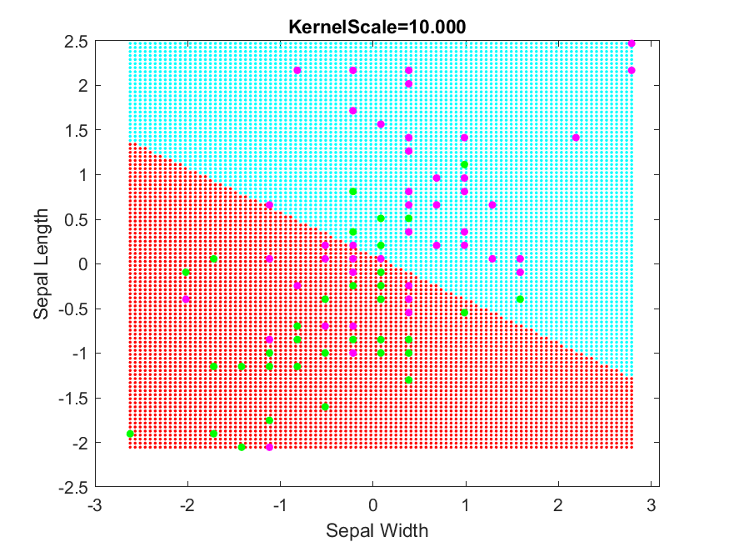
Visualisation: changing KernelScale
(Slides updated to match dataset from labs)

Slide 30
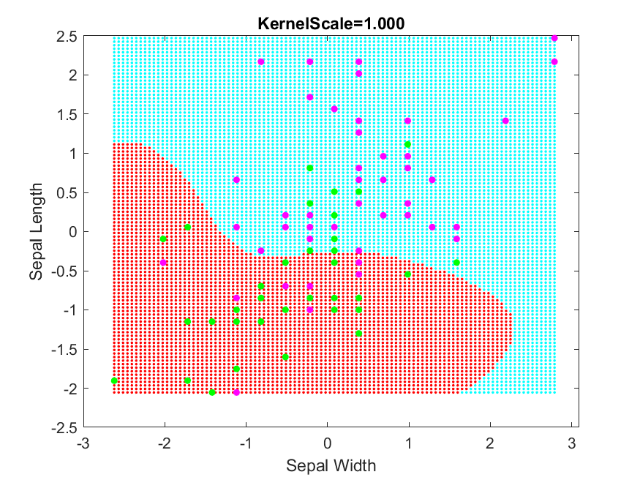
Visualisation: changing KernelScale
(Slides updated to match dataset from labs)

Slide 31
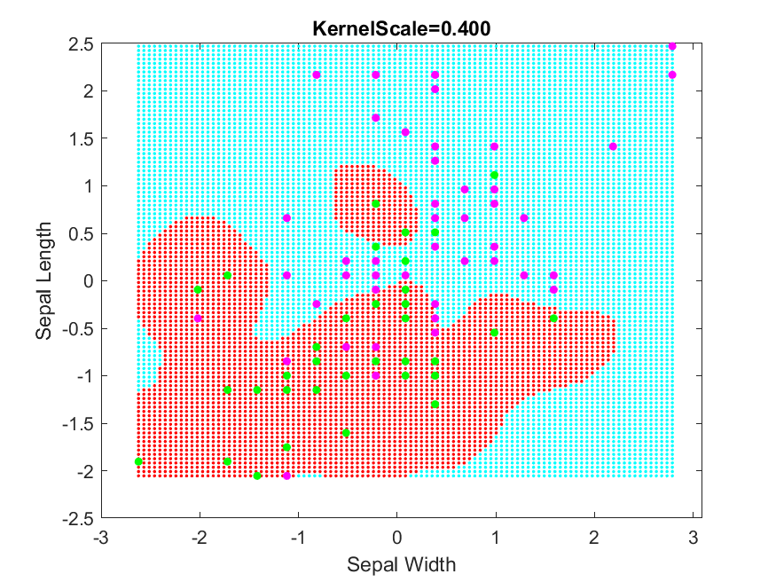
Visualisation: changing KernelScale
(Slides updated to match dataset from labs)

Slide 32
Other considerations
SVMs are sensitive to features having different magnitudes…
…So best to perform z-score standardisation on your data
The fitcsvm() function will accept a 'Standardize' option in the same way as fitcknn()
But careful if you’re trying to do visualisation
Don’t accidentally overlay un-standardised training data

Slide 33
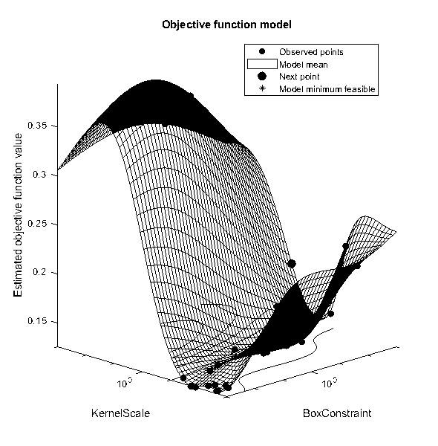
Other considerations
For interest only, not examined…
When dealing with real, challenging, high-dimensional data [hard/impossible to visualise what’s going on]…
You can use Matlab’s 'OptimizeHyperparameters' option to automatically optimise BoxConstraint and KernelScale simultaneously using cross-validation
This is the default behaviour using 'auto'
Warning: can be slow if you have much data…

Slide 34
Reading for next week
Nothing if you already did last week’s reading
Missed doing last weeks, or not feeling too confident with SVMs?
Use the time to have another look
Brett Lantz, “Machine Learning with R”
Chapter 7: “Black box methods – neural networks and support vector machines”
From the section entitled: “Understanding support vector machines”, up to and including the section entitled “using kernels for non-linear spaces”
Suggested approach (but do whatever works best for you):
Just relax and read through
As ever, we’re interested in the ideas, not the use of R

Slide 35
Topics to revisit?
Have left us a bit of a buffer next week
We shouldn’t need the full 50 minutes to finish
Open call for any topics from this term that you’d like us to revisit
Just drop me an email...
Otherwise we’ll probably just re-cap on the exam

